Slide 1

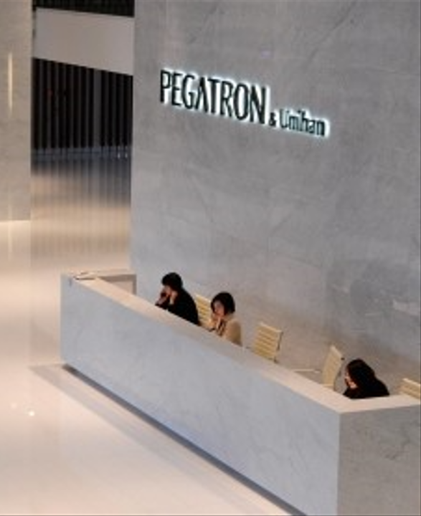


BG6
PVN
2026 PVN FME Q3 工作報告
部門: (PVN)第六事業群-製造及營運管理中心-越南製造處-PVN1廠-FME部-自動化課
姓名: Leon_Than
職等: 19
日期: 2026/09/18
FME
BG6 PVN

Slide 2
BG6
PVN
2026 - Annual Q2–Q3 Work Achievements
Time | Work Result
2026 Q2 | 1. Continue complete unfinished AOI Projects at F5-4F of Q1-2026.
 | 2. Complete new AOI External projects at F5-4F and F5-5F. Improve missing component issue and detect function.
 | 3. Add new function for AOI Carton Machine of 4K-Panasonic.
 | 4. Build Fixed Inspection Box to Enhance Detection Accuracy.
2026 Q3 | 5. Combine Inspection Process for AOI Station in Revlon/Aurora/CCX Series.
 | 6. Setup and Build the Program for AOI Label Station in Eero W/X.
 | 7. Manage and organize human resources of Software and Vision Team. Ensure production and customer requirements. Meet automation needs.
 | 8. Continue perform plans and goals for the F5-5F AOI External Station.
FME
BG6 PVN

Slide 3
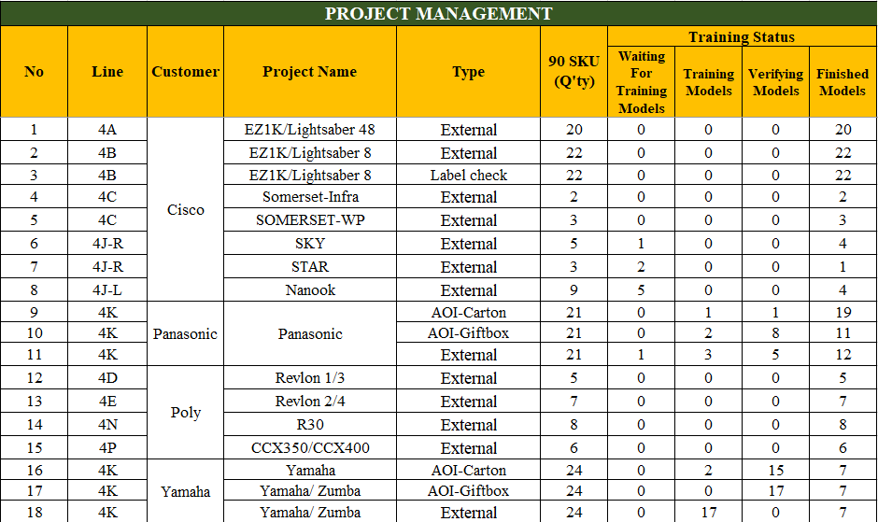
BG6
PVN
Detailed description of work results
1. Continue complete unfinished AOI Projects at F5-4F of Q1 - 2026.
Project Process
  EZ1K/Lightsaber Series : Completed AOI External and Label Check projects.
  Somerset Series : Somerset-Infra and Somerset-WP projects are completed.
  Sky/Star/Nanook Series : Projects are in progress, mainly waiting for training models.
  Panasonic Series : AOI Carton, AOI Giftbox and External projects are under training and verification
  Revlon/R30/CCX Series : Most projects have been completed.
  Yamaha/Zumba Series : Projects are currently in training and verification stages
Quanlity & Improvement
  Maintain stable inspection performance.
  Improved defect detection accuracy and reduced false detection.
  Continued AI training and verification.
  Optimized inspection functions based on actual production feedback
FME
BG6 PVN

Slide 4
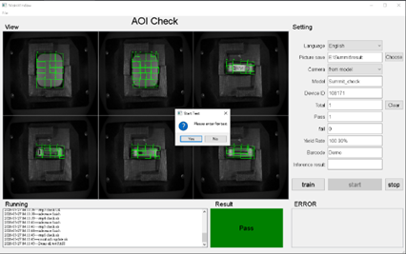
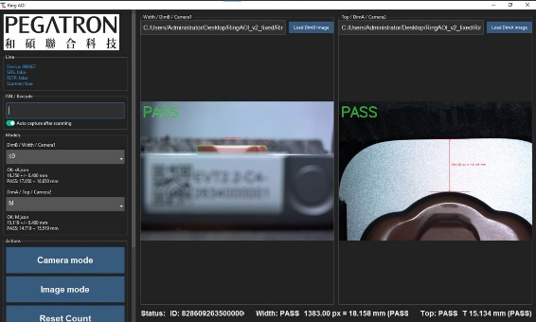
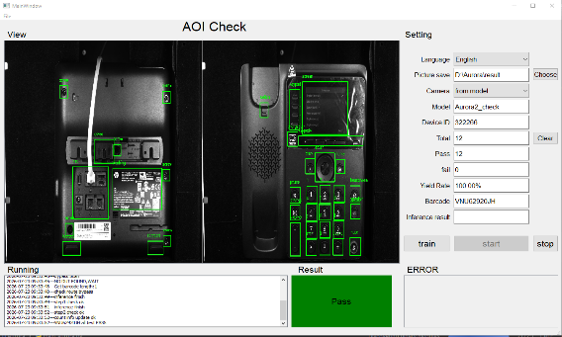
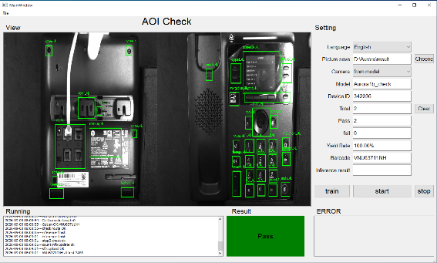
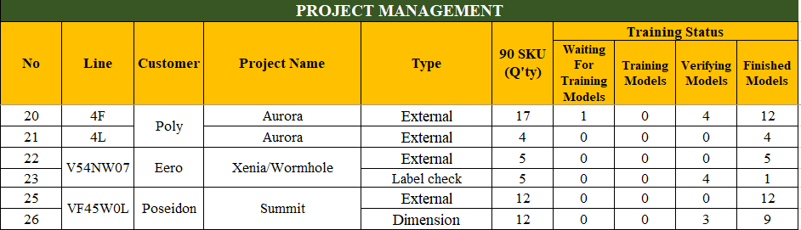
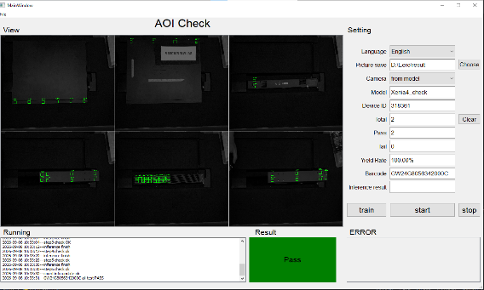
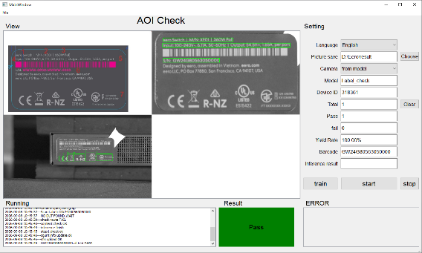
BG6
PVN
Detailed description of work results
2. Complete new AOI External projects at F5-4F and F5-5F. Improve missing component issue and detect function.
Project Process
  Eero Xenia/Wormhole: External project is completed ; Label Check is under verification.
  Aurora Series : Most projects have been completed successfully and are under verification.
  Summit Series : External project is completed ; Dimension project is under implementation and optimization
Quanlity & Improvement
  Ensured stable inspection results and improved defect detection accuracy.
  Continued training and verifying AI models for new projects.
  Optimized inspection parameters to reduce false detection and improve system stability.
Summit Series
Aurora Series
FME
Eero W/X Series
BG6 PVN

Slide 5
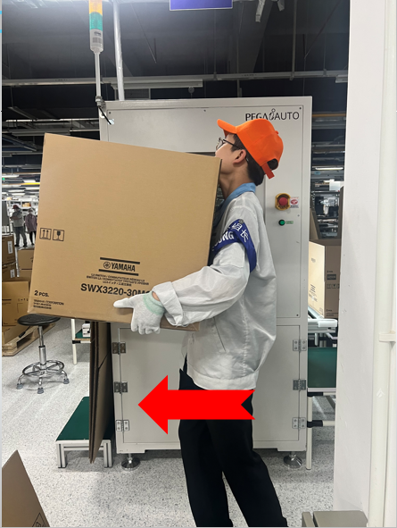
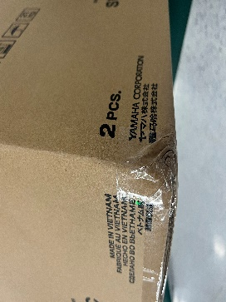
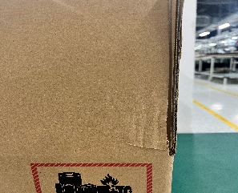
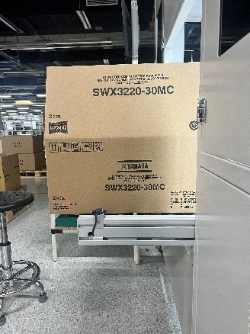
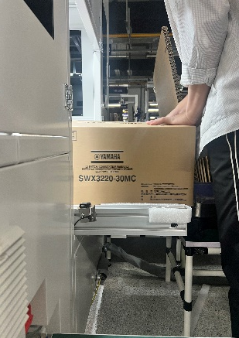
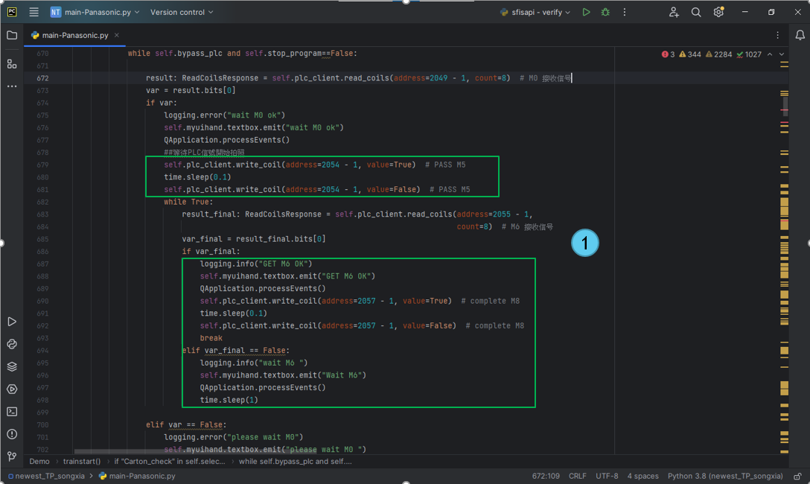
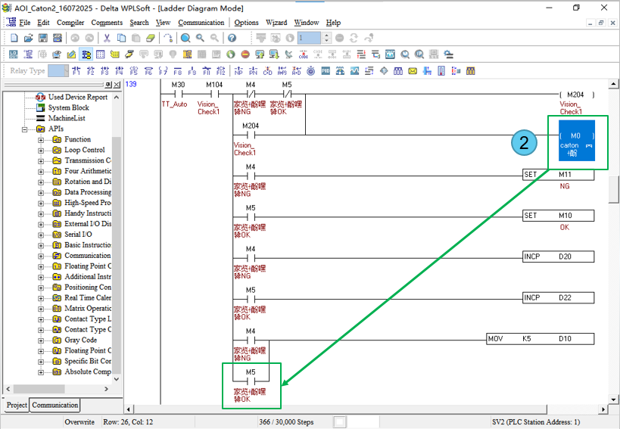
BG6
PVN
Detailed description of work results
3. Add new function for AOI Carton Machine of 4K-Panasonic
Location: 4K – Panasonic – Station AOI Carton
Model: Panasonic
Before Improve
Due to their large size, the K10 and WET stations of the Zumba model must be operated manually. After operation, the cartons must be manually moved onto pallets.
This results in increased time, labor, and a potential risk of collisions during transportation.
Details Improve
Program Improvement :
  Added bypass function, transmit the M0 and M5 signal to the PLC.
  If the bypass mode is set => The program will change the mode and transmit signal to PLC.
PLC Improvement :
  When the program change the mode => The PLC receives the signal => The conveyor will automatically move
Before Improve
After Improve
After manually operating the K10 and WET stations, the operator (OP) uses the bypass mode of the AOI Carton to transport the cartons.
Thensuresis reduces operating time and no collisions occur during transport.
After Improve
FME
BG6 PVN

Slide 6
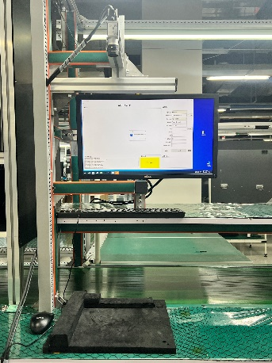
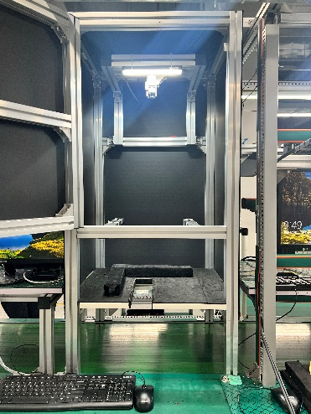
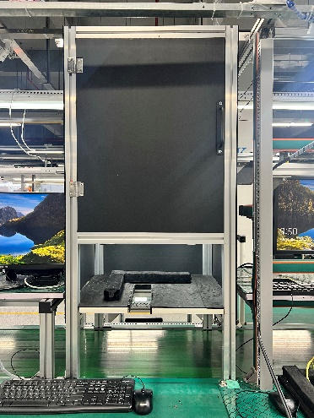
BG6
PVN
Detailed description of work results
4. Build Fixed Inspection Box to Enhance Detection Accuracy
Location: 4D/E/P/L/F – Station AOI External
Model: Revlon/CCX/Auora Series
Before Improve
AI recognition result is affected by environmental light variation.
Open inspection area allows external light to enter the camera field.
Brightness changes cause unstable image quality and false NG judgement.
Before Improve
Details Improve
Design a closed inspection box for AOI External Station.
Use black internal panels to absorb ambient light.
Isolate external factory lighting.
Stabilize image acquisition conditions.
After Improve
Quality
Reduce false NG judgement.
Improve Missing Item detection accuracy
Increase customer confidence
Productivity
Reduce operator review workload
Improve AOI station efficiency
Shorten product verification time
After Improve
FME
BG6 PVN

Slide 7
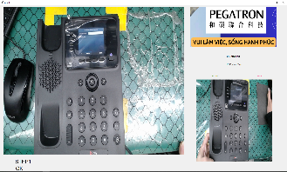
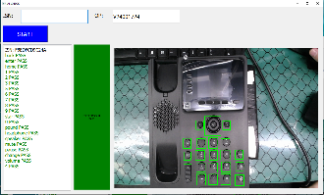
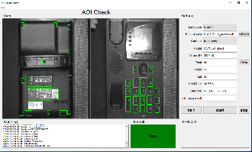
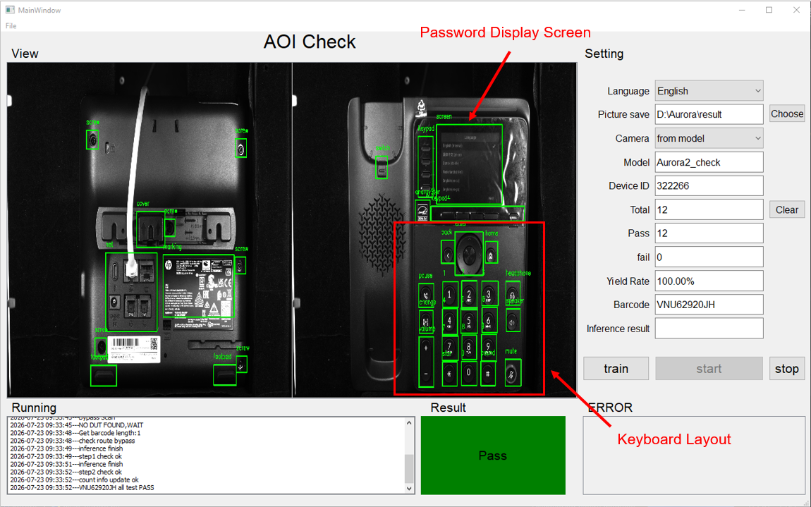
BG6
PVN
Detailed description of work results
5. Combine Inspection Process for AOI Station in Revlon/Aurora/CCX Series.
Location: 4D/E/P/L/F – Station AOI External
Model: Revlon/CCX/Auora Series
Before Improve
Current production line has 3 separate inspection station :
  External AOI ( Visual Inspection )
  Password Check
  Keyboard Inspection by AI
Multiple stations create duplicated inspection activities.
Increased operator manpower and production space.
Details Improve
Integrate External AOI, Password Check and Keyboard Inspection into one inspection station.
Training AOI Software to inspect :
  External Inspection of Components.
  Keyboard Layout.
  Password Display Screen.
Before Improve
After Improve
Quality
Reduce inspection variation.
Maintain inspection accuracy.
Reduce missing inspection items.
Standardize inspection process
Productivity
Reduce 3 -> 1 stations.
Save operator manpower.
Improve production efficiency.
Shorten production cycle time.
After Improve
FME
BG6 PVN

Slide 8
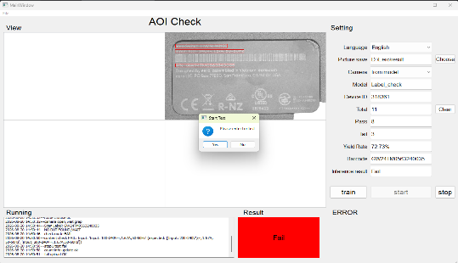
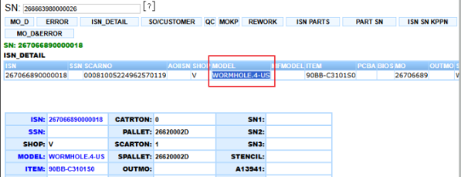
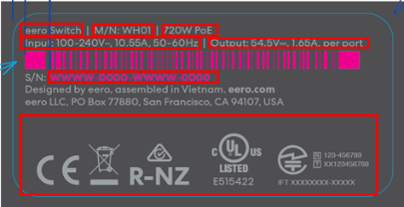
BG6
PVN
Detailed description of work results
6. Setup and Build the Program for AOI Label Station in Eero W/X.
Before Improve
Scan the DSN Label and retrieve the corresponding model information from SFIS.
AOI compares :
  Model information from SFIS.
  Actual model information on the physical label.
  Label artwork/content according to the approved specification.
If the information matches -> PASS
If the information does not match -> FAIL / NG, preventing the wrong label from proceeding to the next process.
Issue
Current label inspection does not have an automatic check to verify actual product label vs model information in SFIS.
Operator mainly performs visual inspection, creating risk of :
  Wrong product label applied to product.
  Model/ artwork mismatch not detected before shipment.
  Human error during label checking.
Impact
Risk of incorrect DSN/POD label on finished product.
Potential customer complaint and rework.
Additional inspection and handling time.
Inspection accuracy depends on operator.
Details Improve
Improvement – Setup AOI Label Inspection Station.
Set up an additional AOI Label Station at Packing VI to automatically verify DSN label content.
After Improve
Quality
Prevent wrong product label.
Automatically detect model/ label.
Standardize inspection process.
Productivity
Reduce manual inspection.
Avoid rework caused by wrong label
Improve production control.
FME
BG6 PVN

Slide 9
BG6
PVN
Work and Self-Development Plan: Q4 2026 – Q1 2027
Time | Work and Self-Development Plan
2026 Q4~ | Continue to improve Chinese skills
 | Continue to improve robot and PLC problem solving skills
 | Improve problem solving skills
 | Improve programming skills
 | Improve manage and organize human skills
FME
BG6 PVN

Slide 10
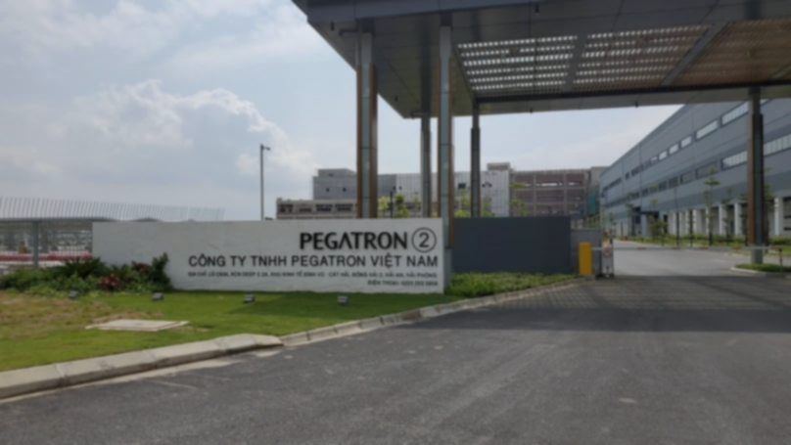
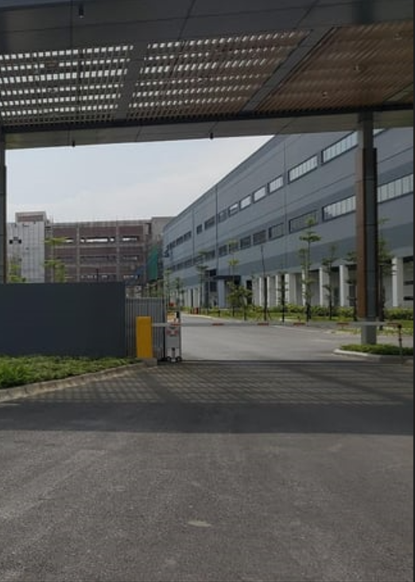
Thank You

